Slide 1


LOGIN FORM TESTING
Ensuring Secure and Reliable Login Through Functional and Boundary Testing

Slide 2

Team Members
2300090032 - NAGABOINA VENKATA SAI KRISHNA
2300090074 - SEELAM AKHIL KUMAR REDDY
2300090111 - SHAIK SUMAIYA SAMREEN
2300090352- KOPPINEEDI VEERA VENKATA SATYANARAYANA

Slide 3
Presentation Contents
1
Introduction & Problem
Understanding the critical need for robust login security.
2
Existing Solutions & Limitations
Review of current testing approaches and their shortcomings.
3
Proposed Testing Framework
A new, comprehensive strategy for login validation.
4
Technologies & Application
Tools and real-world use cases for our framework.
5
Expected Outcomes & Conclusion
Anticipated benefits and future implications.

Slide 4

Introduction: The Critical Role of Login Forms
Login forms are the first line of defense for any digital system.
They protect sensitive user data and ensure only authorized users can access the system.
Improperly tested login forms can lead to:
Unauthorized access to data
Login errors for valid users
Security vulnerabilities like SQL injection
Proper testing ensures:
Only valid users can log in
Errors are handled safely and clearly
Strong passwords and secure input handling

Slide 5
Problem Statement: Common Login Form Vulnerabilities
Login forms often suffer from critical flaws that, if exploited, can lead to severe security breaches. These issues stem from various shortcomings in validation and error handling.
Weak Password Policies
Insufficient Input Validation
Login forms may allow easily guessable or commonly used passwords, making accounts vulnerable to dictionary and brute-force attacks.
Failure to properly sanitize user inputs can lead to injection attacks (e.g., SQL Injection, XSS) that compromise data or execute malicious code.
Verbose Error Messages
Poor Session Management
Overly descriptive error messages can reveal sensitive information about the system's internal structure or validate usernames, aiding attackers.
Improper handling of user sessions can lead to session hijacking, fixation, or token prediction, allowing unauthorized access.
No Brute-Force Protection
Missing Multi-Factor Auth
Lack of mechanisms like rate limiting or account lockouts allows attackers to repeatedly guess credentials until they succeed.
Without multi-factor authentication, a compromised password is often enough for an attacker to gain full access to an account.

Slide 6
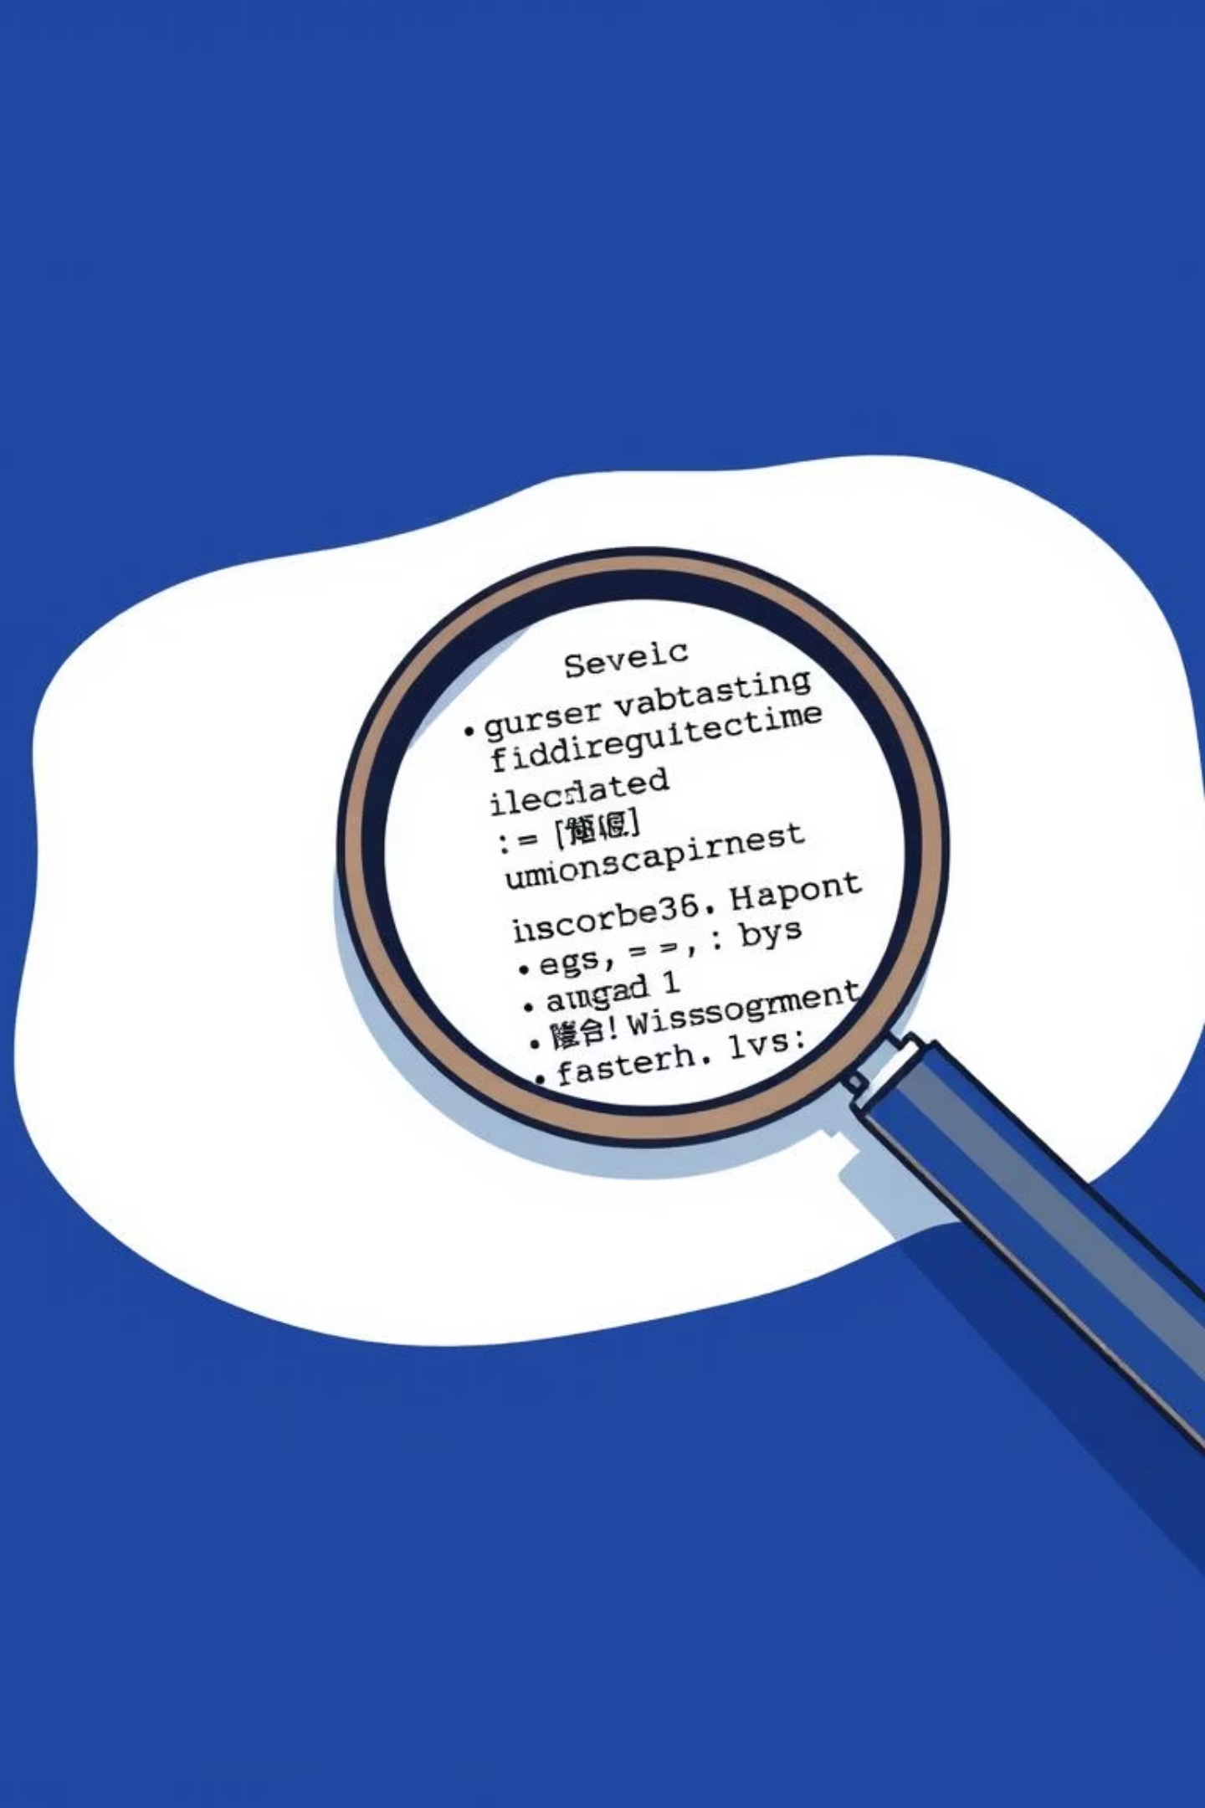
Existing Login Testing Methods and Their Limitations
While various testing methods exist, they often provide incomplete coverage, leaving gaps that can be exploited by malicious actors.
Current Approaches
Identified Limitations
Basic functional tests (valid/invalid credentials)
Lack of comprehensive boundary value analysis (BVA)
Manual penetration testing
Inadequate focus on injection vulnerabilities
Limited automated UI tests
Unit tests for backend authentication logic
Inconsistent error message validation across systems
Time-consuming manual security checks
Limited coverage of complex password policies

Slide 7
Proposed Solution: A Comprehensive Testing Framework
Our framework integrates multiple testing methodologies to ensure robust login security and reliability, addressing the limitations of existing approaches.
01
02
Enhanced Functional Testing
Boundary Value Analysis (BVA)
Automating comprehensive scenarios including valid, invalid, locked, and expired accounts. Verifying success and failure messages precisely.
Systematic testing of input fields (usernames, passwords) at their minimum, maximum, and edge values to uncover subtle bugs.
03
04
SQL Injection Prevention
Password Strength Checks
Specialized tests to detect and prevent common and advanced SQL injection attempts through the login form.
Validating password complexity requirements, minimum length, special characters, and dictionary attacks.

Slide 8

Tools Used in Login Form Testing Project
Selenium WebDriver
For automating browser-based interaction.
Simulates real user actions (entering credentials, clicking login, handling errors).
JUnit 5
For structured test case management and execution.
Supports parameterized testing (test multiple sets of credentials easily).
Allure Reports / HTML Reports
For reporting and visualization of test results.
Provides pass/fail summaries, defect insights, and execution history.
SQL Injection Testing Tools (or manual injection attempts).
Used for security validation.
Can include OWASP ZAP / Burp Suite (though your write-up mainly said "SQL injection attempts").

Slide 9




Key Technologies and Methodologies
Leveraging industry-standard tools and techniques, our framework provides a robust and efficient testing pipeline.
Black-Box Testing
Selenium
Testing login functionality without internal knowledge of the system's code structure.
Automating browser interactions for functional and UI-based login tests.
JUnit/TestNG
SQL Testing
Frameworks for structuring and executing automated test cases, managing test suites, and generating reports.
Specifically designed tests for detecting SQL injection vulnerabilities and verifying database interaction security.

Slide 10
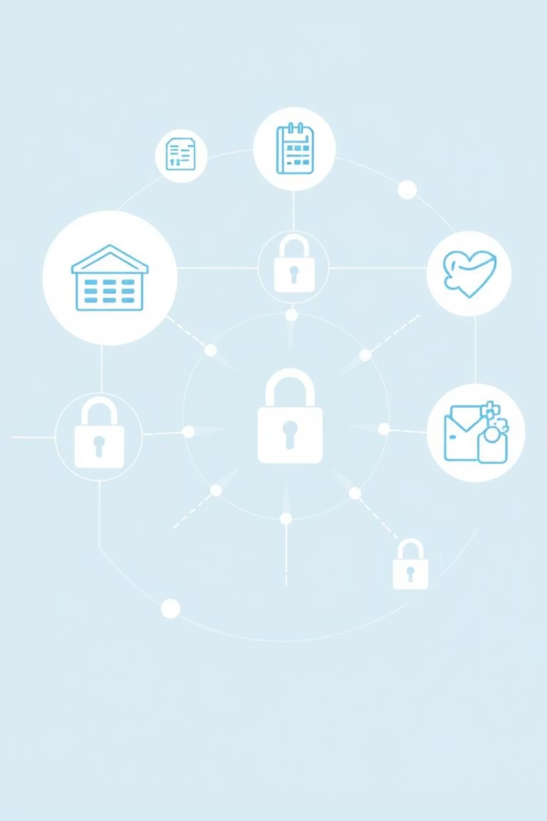
Broad Areas of Application
A secure login framework is indispensable across various industries where data integrity and user trust are paramount.
Banking & Finance: Protecting sensitive financial data and transactions.
Mobile Applications: Ensuring secure access on various devices and platforms.
E-commerce: Securing customer accounts, payment information, and order history.
Education Platforms: Protecting student and faculty data, academic records, and intellectual property.
Enterprise Systems: Safeguarding internal company data, employee records, and confidential business operations.
Healthcare Systems: Securing patient information and ensuring compliance with privacy regulations.

Slide 11




Expected Output and Deliverables
Our framework will produce concrete deliverables that offer clear insights into the security posture and reliability of login mechanisms.
Functional Test Cases & Results
Boundary Test Results
Detailed reports on pass/fail status for all login scenarios.
Analysis of input field vulnerabilities at critical boundaries.
Security Vulnerability Report
Improved Reliability & Security
Identification of SQL injection and other security flaws with recommendations.
A demonstrably more secure and robust login system.

Slide 12

Conclusion: Towards a More Secure Digital Future
The implementation of a comprehensive login testing framework is not just a best practice; it's a necessity in today's digital landscape.
"By investing in thorough functional and boundary testing for login forms, organizations can significantly mitigate risks, protect user data, and build unwavering trust."
This framework empowers developers and QA engineers to deliver applications with superior security and reliability, fostering a safer online experience for everyone.

